Slide 1

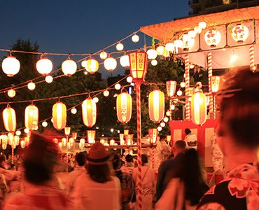


Obon
Human Relations, Diversity & Equity
Student Support and Attendance Services Branch

Slide 2
Welcome
Which would you rather have as a pet?
elephant
Lion

Slide 3
Objectives
Learn about the Buddhist holiday, Obon
Review the traditions behind the holiday
Discuss special holidays you celebrate in your culture

Slide 4

What is Obon?
Notes:
3:45
What You Need To Know About Obon - Inside Japan - お盆 - YouTube

Slide 5
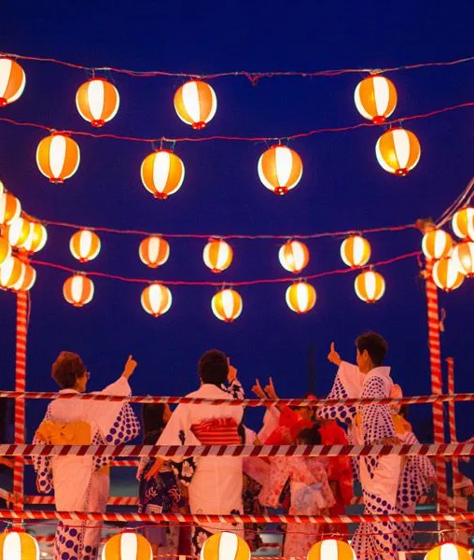
Ancient Holiday
Obon is a three day holiday that has been celebrated in Japan for over 500 years.
Obon is often recognized as celebration with Buddhist-Confucian roots.
Many employers give their workers leave at this time so they may travel and hold family reunions.
Families gather during Obon to honor their ancestors and loved ones who have died.

Slide 6
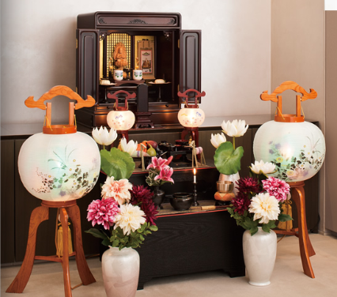
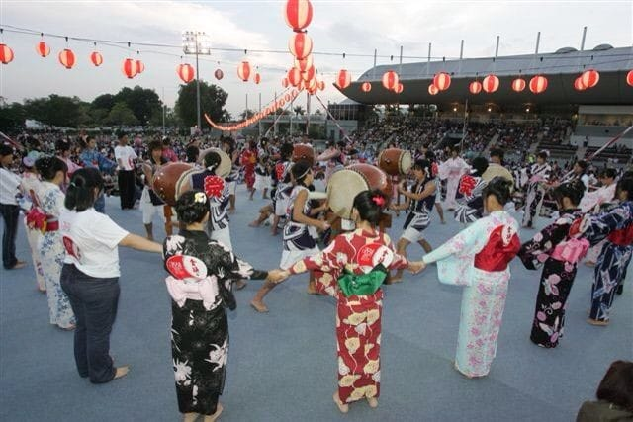
Tradition
This ancient holiday follows many traditions.
Lanterns are used guide the spirits to their families
Participants wear yukatas throughout the celebration.
Families assemble household altars for their deceased loved ones.
A traditional dance called Bon Odari is often included in the celebration.

Slide 7

Reflection
Does this particular holiday remind you of any other holidays you have heard of?

Slide 8
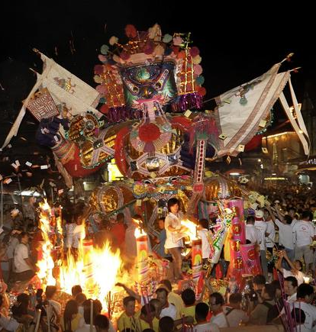
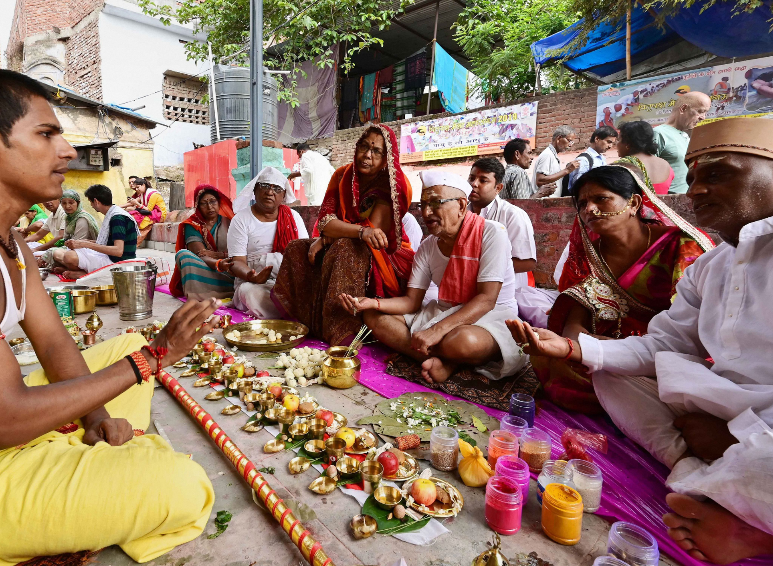
Similar, but different.
The Ghost Festival is a traditional Taoism and Buddhist festival held in certain East Asian countries (including China and Vietnam).
In India, Pitri Paksha is celebrated, a 16–lunar day period in Hindu calendar when Hindus pay homage to their ancestors (Pitrs), especially through food offerings
Koreans celebrate Baekjung, where participants present offerings at Buddhist shrines and temples, and masked dances are performed. It is as much an agricultural festival as a religious one
Notes:
Top Picture from Ghost Festival in China
Bottom Picture from Pitri Paksha in India

Slide 9
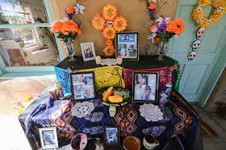
But wait, there's more!
Dia de Los Muertos is another multi-day holiday where family and friends gather to pray for and to remember friends and family members who have died.
Similar to Odon, this tradition often includes an altar.

Slide 10
Reflection
Does your family have any special holiday to honor your ancestors?

Slide 11

Check Out
What is your favorite holiday to celebrate and why

Slide 12

Teacher Survey
Notes:
Teacher, please scan the QR code to complete a brief survey.

Slide 13
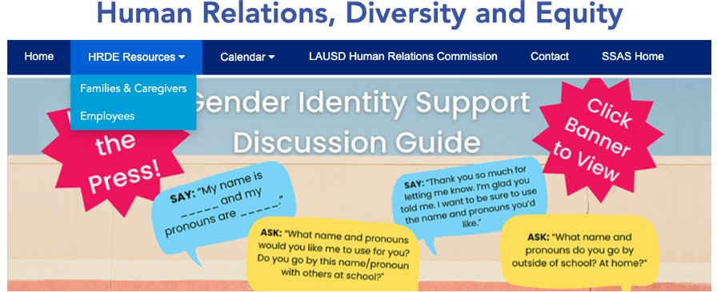
Human Relations, Diversity & Equity
For additional resources visit us at:
https://www.lausd.org/human-relations

